Slide 1
Flight Dynamics Reference
Common Simulation Architecture (CSA)
October 7, 2010
Mike Sufana
CSA Primary Investigator

Slide 2
Contents
These charts document common functions in the CSA Library
Acronyms and Documentation Formatting
Reference Coordinate Systems and Equations
Reference Equations

Slide 3
Acronyms and Documentation Formatting
Documentation formatting
MATLAB Scripts / Functions - bold
MATLAB Workspace Variables - Courier New Font
Simulink Subsystem Blocks - Italic
External Documents - Underline
Acronyms shall be clearly defined
Acronym | Description
CM | Configuration Management
CoP | Community of Practice
CoSMO | Common Simulation Modeling Object
CoSMO’d | Act of creating a CoSMO and all associated documentation
CSA | Common Simulation Architecture
DCM | Direction Cosine Matrix
GNC | Guidance, Navigation, & Control
I/O | Input / Output
RTCF | Real-Time Component Framework
NGC | Northrop Grumman Corporation

Slide 4
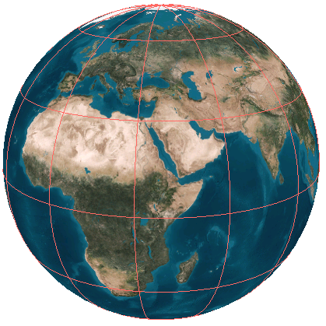

Flight Dynamics Reference Coordinate Frame Definitions
Vehicle Body Frame (B)
Origin at Vehicle’s Center of Gravity; Right-handed system
X_{B} axis – Parallel to vehicle’s longitudinal axis; positive towards nose
Y_{B} axis – Positive out right wing or wall of vehicle
Z_{B} axis – Positive out vehicle floor or feet; Negative through head
Central Body Inertial (I)
Origin at Center of Central Body; Right-handed system
X_{I} axis – In Direction of the Vernal Equinox in Plane of Equator
Z_{I} axis – Parallel to the Central Body’s Spin Axis; Positive Towards North Pole
For Earth, referred to as the Earth Centered Inertial (ECI) Frame
Also Known as the “Celestial Coordinate Frame”
Central Body Fixed (F)
Origin at Center of Central Body; Right-handed system
X_{F} axis – In Direction of the Greenwich Meridian in Plane of Equator; Points Towards 0˚ Longitude
Y_{F} axis – In Plane of Equator; Points Towards 90˚ East Longitude
Z_{F} axis – Parallel to the Central Body’s Spin Axis; Positive towards North Pole
For Earth, referred to as the Earth Centered Earth Fixed (ECEF) frame
μ – mean sidereal time – angle between Inertial and Fixed’s x-axis, positive east
z_{i,}, z_{f}
North Pole
y_{B}
x_{B}
z_{B}
Vernal Equinox
Equatorial
Plane
x_{i}
µ
µ
y_{f}
x_{f}
Greenwich Meridian (Earth)
y_{i}
Globe from AGI STK

Slide 5
Flight Dynamics Reference Coordinate Frame Definitions
Spherical (LLA)
Origin: Central Body
δ - Geocentric Latitude: Angle between equatorial plane and a line from center of central body
φ_{GD} - Geodetic Latitude: Angle between the equatorial plane and a line that is normal to the reference ellipsoid
l_{G} - Longitude: Angle from prime meridian (positive East)
Altitude: Height above reference ellipsoid
North/East/Down (NED)
Right Handed System
Origin: Vehicle
X-axis (N): Always points towards North Pole
Y-axis (E): Points East
Z-axis (D): Points to Center of Central Body (nadir)
x_{NED}
y_{NED}
z_{f}
North Pole
z_{NED}
Equatorial
Plane
φ_{GD}
x_{f}
y_{f}
Greenwich Meridian (Earth)
l_{G}
Globe from AGI STK
δ
alt
φ_{GD}

Slide 6
Flight Dynamics Reference Coordinate Frame Definitions
Local Vertical Local Horizontal Coordiante System (LVLH)
Origin at Vehicle’s center of gravity; Right Handed System
X_{LVLH} axis - In orbital plane, points through nose of vehicle towards velocity vector (if orbit eccentricity is zero, X_{LVLH} is parallel to velocity vector)
Y_{LVLH} axis - Positive out right wing of vehicle; completes coordinate system (Z_{LVLH} x X_{LVLH})
Z_{LVLH} axis - Positive through bottom of vehicle; points to center of central body (NADIR)
Satellite Coordinate System (ONF)
Origin at Vehicle’s center of gravity; Right Handed System
Sometimes called the Gaussian Coordinate System
X_{ONF} axis - Always points from the center of central body to vehicle Positive out (negative NADIR)
Y_{ONF} axis - In orbital plane, points towards velocity vector (if orbit eccentricity is zero, Y_{ONF} is parallel to velocity vector)
Z_{ONF} axis - Cross-track axis; Completes coordinate system (X_{ONF} x Y_{ONF})
z_{i}
x_{i}
y_{i}
Globe from AGI STK

Slide 7
Vned2GammaChiVtrue Reference Data
Coordinate Frame Definitions
χ (chi), flight path heading angle; horizontal angle between north and the projection of the velocity vector on the horizontal plane; positive rotation is from north to east
γ (gamma), flight path elevation angle; vertical angle between the velocity vector and the horizontal plane; positive rotation is up
V_{True}, total vehicle velocity
V_{N}
V_{T}
χ
γ
V_{H}
V_{E}
V_{D}
V_{N}
χ
V_{H}
V_{E}
V_{T}
γ
V_{H}
V_{D}

Slide 8
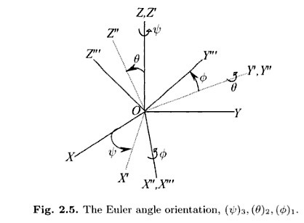
Flight Dynamics Reference Reference Equations (1 of 2)
This function uses Euler angles and direction cosine matrix (DCM) transformations. For reference, the transformations for the standard 3-2-1 aircraft Euler angles (roll, pitch, yaw or φ, θ, ψ) are reviewed here.
The DCM is constructed from the multiplication of 3 individual matrices:
Euler angles are recovered from the DCM using basis trigonometric functions:
1 ← 2 ← 3
Schmidt, Louis V. Introduction to aircraft flight dynamics AIAA (American Institue of Aeronautics and Astronautics) Educational series

Slide 9
Flight Dynamics Reference Reference Equations (2 of 2)
This function converts a vehicle’s body orientation with respect to the inertial frame to the vehicle’s body orientation with respect to the fixed reference frame. The steps required to perform this transformation are outlined here:
Step 1: Compute ^{i}C^{f}, which is the transpose of ^{f}C^{i}, from the mean sidereal time, μ
^{i}C^{f}: DCM that transforms fixed reference frame data into the inertial reference frame
Step 2: Compute ^{b}C^{i} from inertial Euler
^{b}C^{i}: DCM that transforms inertial reference frame data into the vehicle’s body frame
Step 3: Perform DCM matrix multiplication to derive ^{b}C^{f}
^{b}C^{f}: DCM that transforms fixed reference frame data into the vehicle’s body frame
Step 4: Perform trigonometric functions to compute fixed Euler

Slide 10
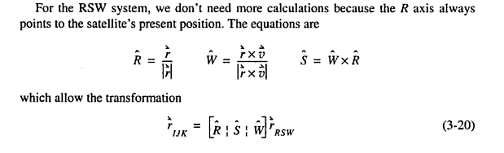
eul_i_2_eul_lvlh Reference Data
Coordinate Frame formulas
Vallado, David A. Fundamentals of Astrodynamics and Applications. New York: McGraw-Hill Companies, Inc., 1997.

Slide 11
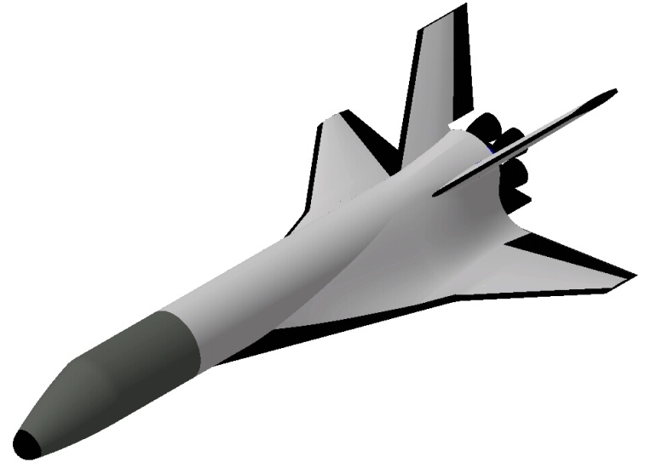
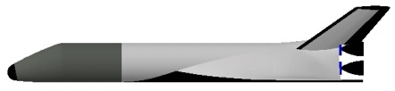
Flight Dynamics Reference Reference Angles
Angle of Attack and Sideslip
L
x_{B}
L
α
D
V_{T}
_
α
z_{B}
y_{B}
α
x_{B}
α
β
z_{B}
V_{T}
_

Slide 12
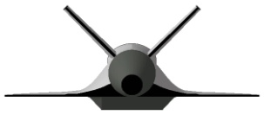
Flight Dynamics Reference Reference Angles
Flight Path Angle & Bank Angle
μ
x_{B}
L
L
α
V_{T}
L
γ
V_{D}
N-E plane
D
μ
α
z_{B}
V_{N}
χ
γ
V_{D}
V_{T}
V_{E}
projection onto
N-E plane

Slide 14
Flight Dynamics Reference Coordinate Frame Definitions
E-Guidance Algorithm
E-Guidance produces an acceleration command in the inertial frame, A_{I Cmd}
This normally means that you want to set the vehicle’s thrust axis (normally the body x-axis) parallel to A_{I Cmd}
But now you’ve got 360º about which the vehicle could be oriented, so you need to lock down another axis so that the vehicle’s attitude can be commanded
One method of setting the attitude is to dictate where either the vehicle’s body y OR body z-axis needs to be. Since we’re talking orbital mechanics here, you typically want that axis to be aligned with some form of the inertial position or velocity vector or both (remember from basic orbital mechanics that h = r x v)
For Lunar Lander, the vehicle was assumed to orbit with the vehicle’s body z-axis pointing towards the center of the central body (due to eccentricity, this is NOT nadir). Since the z-axis command is ‘floating’, the body y-axis was used instead.
The neat trick was to use the cross product of the inertial position and velocity, h. The body y-axis was set to be the opposite of h. This meant that as the vehicle orbited, the pilot head was always moving away from the Central Body.
Depending on the vehicle in question, you could control any other access using a similar method. You basically command two axes, the third one falls out as a function of the cross product, and now you have a DCM (or Euler or Quaternion vector) that your attitude controller can work to.
y_{B}
z_{i}
x_{B}
z_{B}
x_{i}
y_{i}
Globe from AGI STK

